Slide 1
Section 10
Lavender Jiang
See references for sources of images
11/13/2023

Slide 2
Prompt Engineering
P A R T 0 1

Slide 3
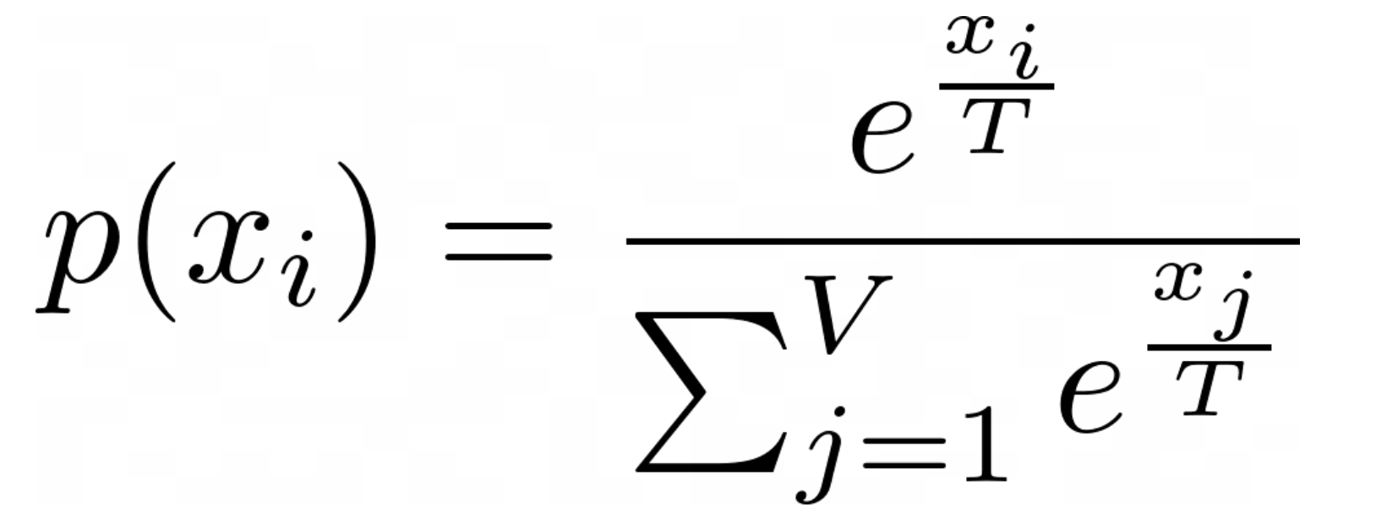
Temperature
P A R T 0 1
What happens when T approach 0? How about infinity?

Slide 4
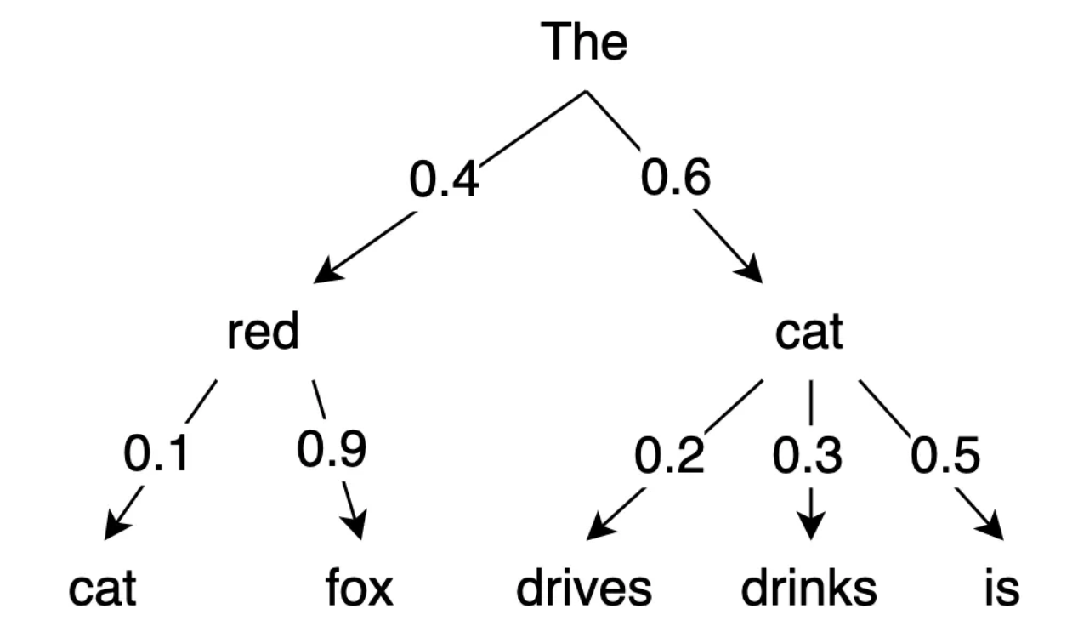
Top-p
P A R T 0 1
How does the following work on the left example:
Greedy search
beam search with n_beam=2
Top-k sampling
Top-p sampling

Slide 5
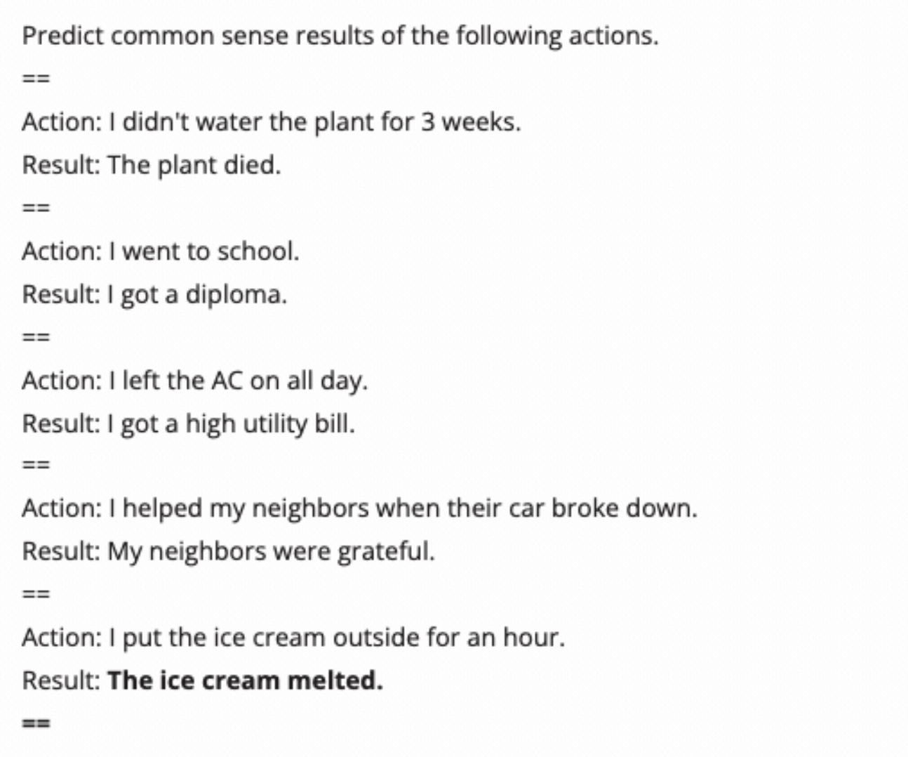
Max Length, Stop Sequences
P A R T 0 1

Slide 6
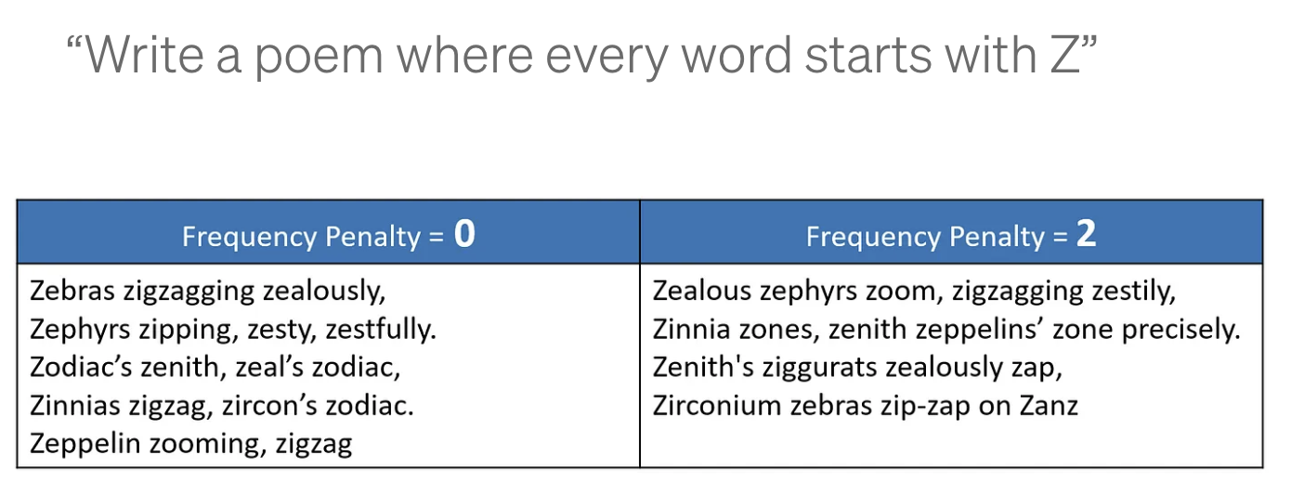
Frequency Penalty
P A R T 0 1

Slide 7
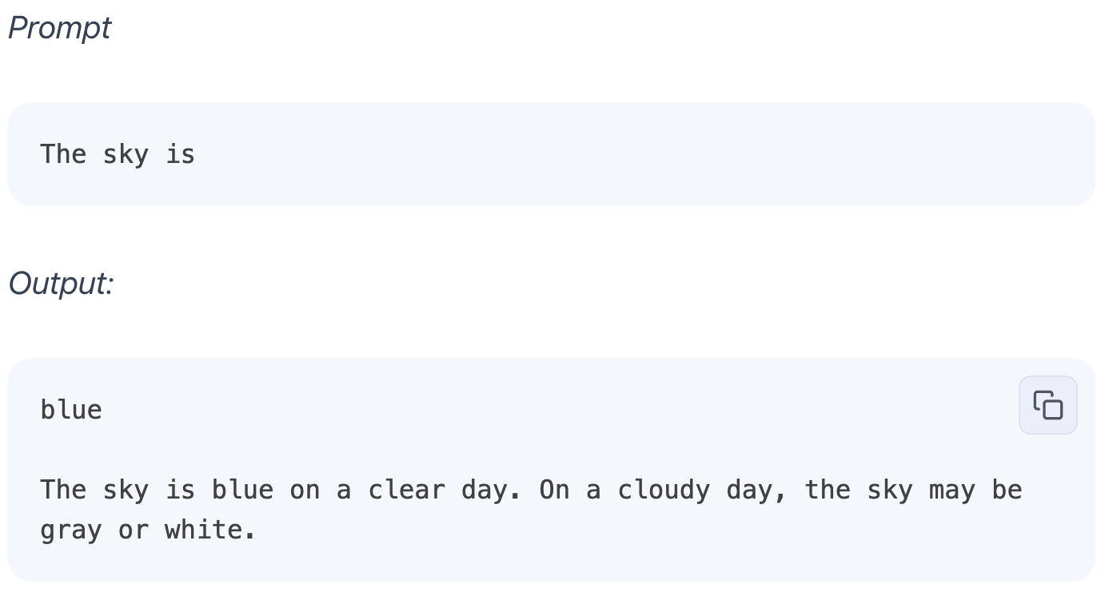
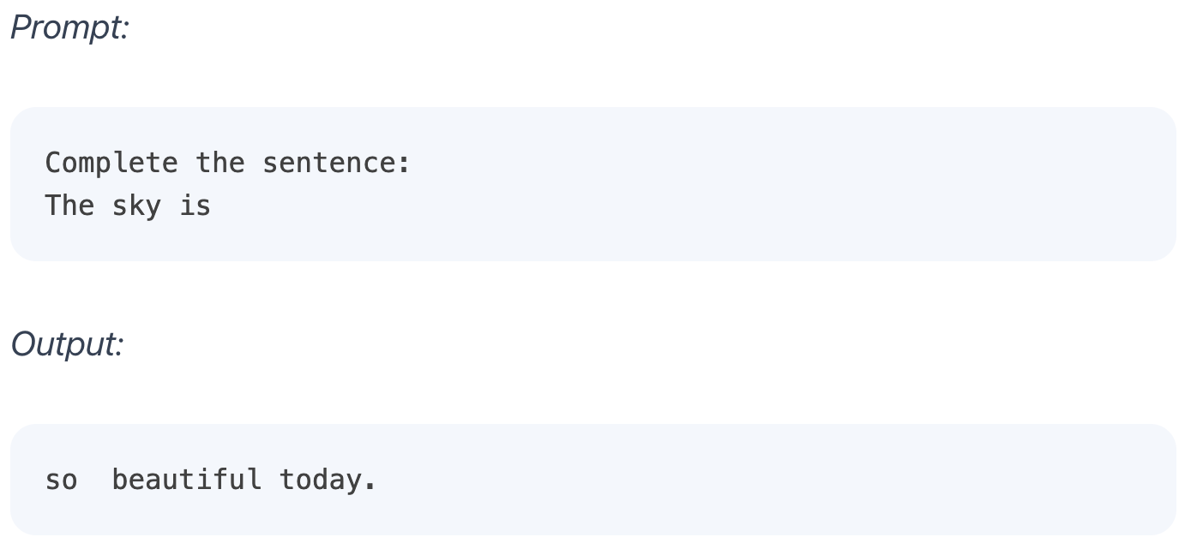
Basic Prompt

Slide 8
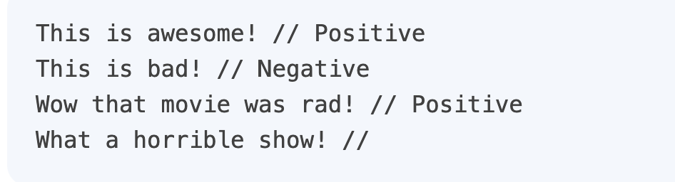
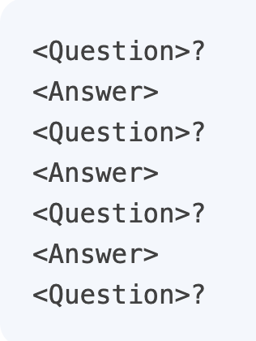
Prompt Formatting

Slide 9
Elements of Prompts
Instruction - a specific task or instruction you want the model to perform
Context - external information or additional context that can steer the model to better responses
Input Data - the input or question that we are interested to find a response for
Output Indicator - the type or format of the output.

Slide 10
Homework: 7-digit addition
Instruction - control with your_prompt
Context - control with your_prompt and your_post_processing
Input Data - given by autograder, can format with your_pre_processing
Output Indicator - controlled by your choice of prompt. Can be further processed with your_post_processing
Other knobs: your_config
Metrics: accuracy, mean absolute error, prompt length
Autograder is slow. Recommend local testing with test_prompts.py
(Exact same code as autograder, but different random seeds)
Note: for submission do not read prompts from files, autograder cannot find it

Slide 11
Huffman
Coding
P A R T 02

Slide 12
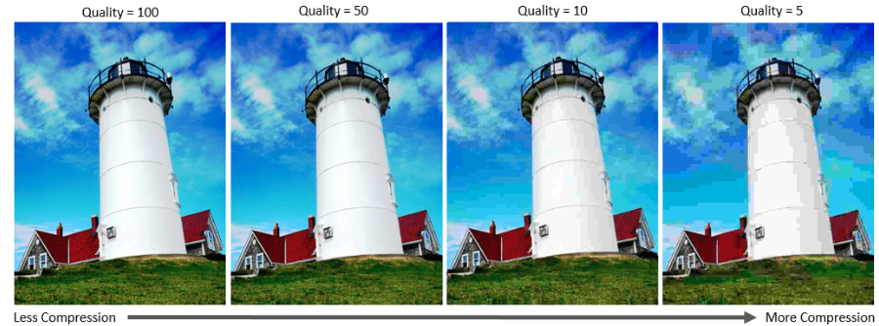
Compression

Slide 13


Which is harder to compress?

Slide 14
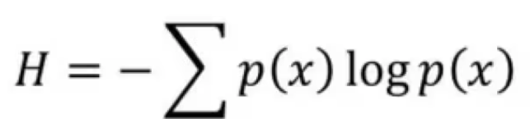

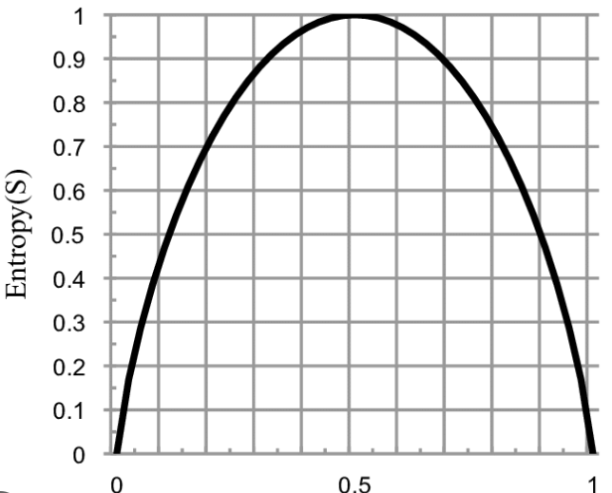
Entropy

Slide 15


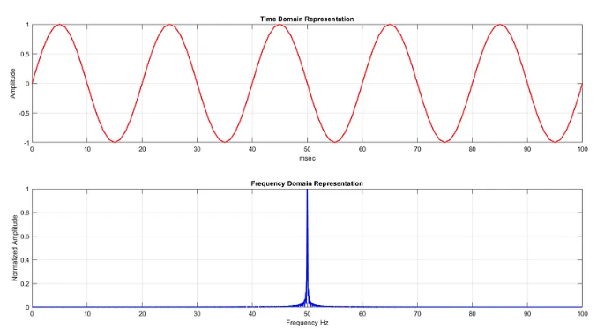
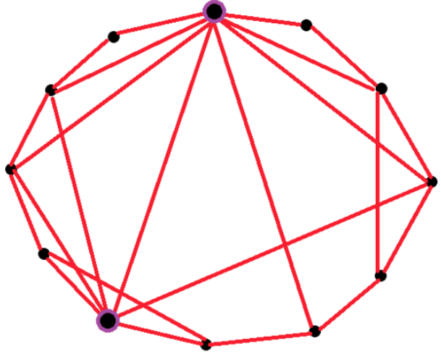

Redundancy
Smoothness/locality prior for image
Periodic prior for sound
Small-world / six-degree
prior for social networks

Slide 16
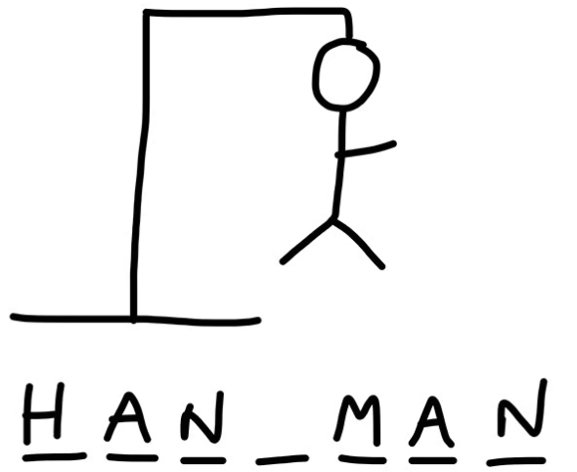
Redundancy in English Text & Entropy of English
Example Rules:
1. i before e except after c.
Hippie, Fries, Field. cake
2. q must always be followed by a u
Quick, quiche, question, quarrel
3. grammar
Cannot do “subject subject” as a sentence
4. dictionary
Hufamomina is not a word
Shannon tried calculating English’s entropy using n-gram
p(x_{n}| x_{<n}). Is this a good approach? O complexity?
Another approach: take a set of English words (8000),
calculate the word-level entropy based on the subset.
Then divide by average number of characters to get
Character-level entropy.
Maximum entropy: ~4.7 bit/letter
Approximated entropy of English: 2.63 bit/letter (why?)
Is English redundant? Is it good or bad?

Slide 17
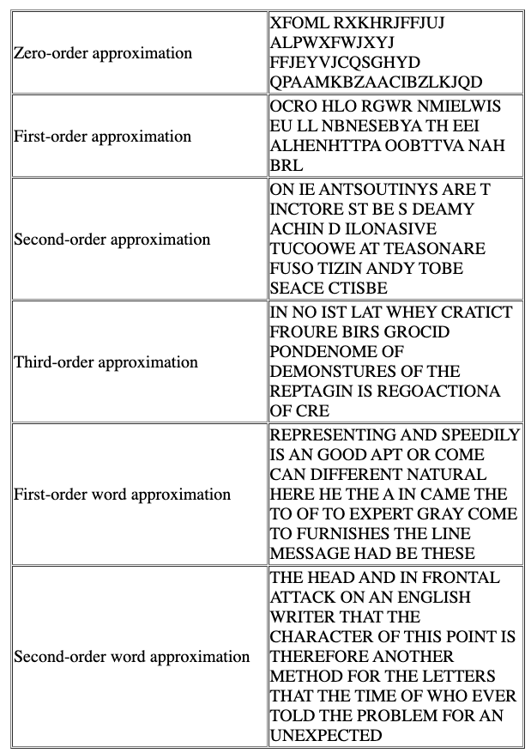
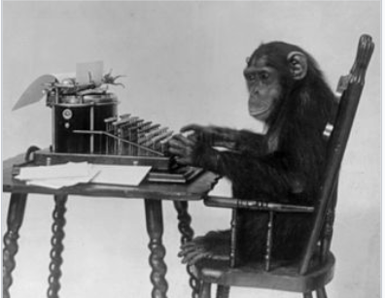
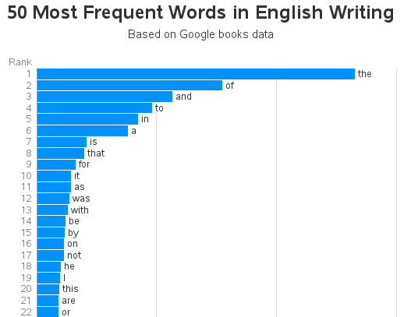
Infinite Monkey Theorem
Almost surely, he would type up Shakespeare.

Slide 18
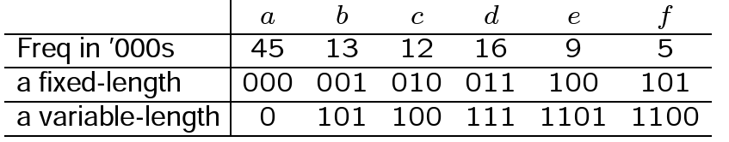
Compression relies on redundancy
Fixed length v.s. variable length encoding
Which scheme uses fewer bits to encode the corpus?
How do we encode “bad”?
How do we decode 11000101? (Is the decoding unique? Why?)

Slide 19
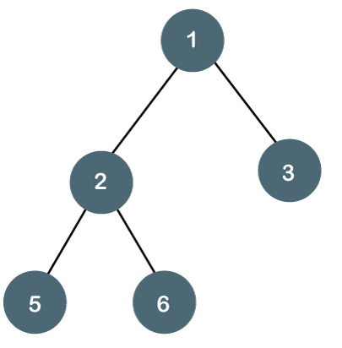
Designing Unique Prefixes with Prefix Tree
Idea:
Greedy bottom-up construction of tree
Read encoding based on path from root to leaves.
Why it works:
Each token traces the path of a leave.
A leave has no children.
So each token has unique prefix.
Why it’s efficient:
Greedy algorithm always look for least frequent token
Less frequent tokens become leaves earlier
Less frequent tokens -> longer path -> longer code

Slide 20
Walkthrough
Pick two least frequent words
Use them as leaves of a subtree
Merge frequency on their common parent
Add common parent back to list
Repeat

Slide 21
Walkthrough
Pick two least frequent words
Use them as leaves of a subtree
Merge frequency on their common parent
Add common parent back to list
Repeat
The tokens here (a,b,c,d,e) can be bigrams!
e.g., a = cat | the, b = on | was

Slide 22
References
https://medium.com/@lazyprogrammerofficial/what-is-temperature-in-nlp-llms-aa2a7212e687
https://medium.com/nlplanet/two-minutes-nlp-most-used-decoding-methods-for-language-models-9d44b2375612
https://docs.ai21.com/docs/when-the-generation-stops
https://towardsdatascience.com/guide-to-chatgpts-advanced-settings-top-p-frequency-penalties-temperature-and-more-b70bae848069
https://www.promptingguide.ai/introduction/basics
https://www.mathworks.com/help/images/jpeg-image-deblocking-using-deep-learning.html
https://www.researchgate.net/figure/Top-The-CNN-trained-for-the-task-of-full-face-detection-Bottom-The-CNN-trained-for-the_fig2_308944615
https://cs.stanford.edu/people/eroberts/courses/soco/projects/1999-00/information-theory/entropy_of_english_9.html
https://home.cse.ust.hk/faculty/golin/COMP271Sp03/Notes/MyL17.pdf

